Slide 1
Introduction to CCSv5
Notes:
1
NEW

Slide 2
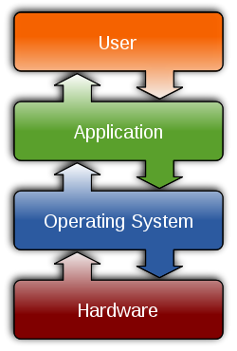
Outline
Intro to CCSv5
Functional Overview
Perspectives
Projects
Target Configuration
Build Config & Options
Licensing/Pricing
CCSv5 – For More Info…

Slide 3
Outline
Intro to CCSv5
Functional Overview
Perspectives
Projects
Target Configuration
Build Config & Options
Licensing/Pricing
CCSv5 – For More Info…

Slide 4
CCS Functional Overview
Compiler
Asm Opto
Standard Runtime Libraries
SYS/BIOS
Libraries
SIM
.asm
.c
.lib
DSK
Edit
.asm
Asm
.obj
Link
Debug
EMU
.out
EVM
SYS/BIOS
Config
(.cfg)
.map
Third
Party
BIOS linker.cmd
User.cmd
Code Composer Studio Includes:
Integrated Edit / Debug GUI
EMU
Simulator
Code Generation Tools
SYS/BIOS: Real-time kernel Real-time analysis
Target Board

Slide 5
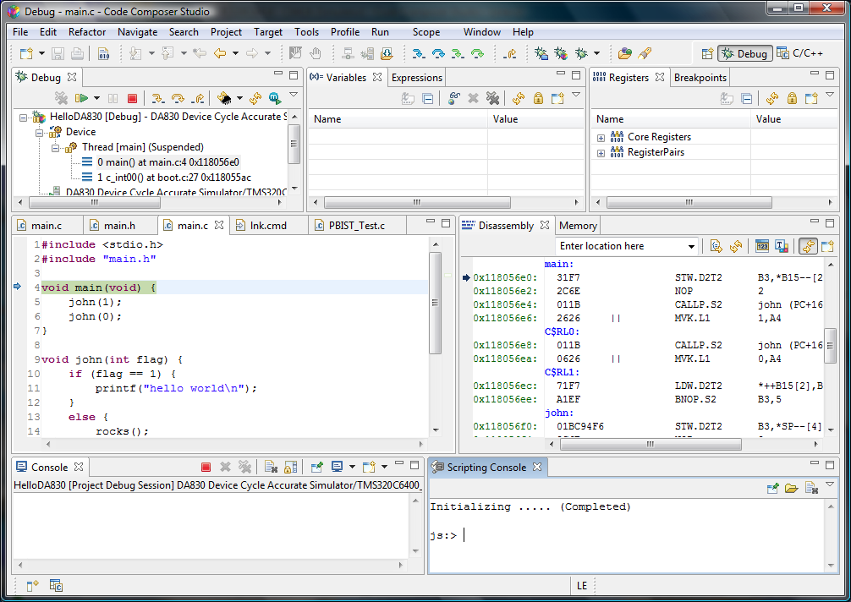
CCSv5 “GUI” Environment – Space Saving
Customize toolbars & menus
Perspectives contain separate window arrangements depending on what you are doing.
Tabbed editor windows
Tab data displays together to save space
Fast view windows don’t display
Until you click on them
Notes:
CCSv4 helps greatly with this problem.
You can customize your menus and toolbars to show just the items you care about.
Tabbed Editor windows make it easier to switch between files.
You can tab any view with another to organize your window layout.
The fast view setting can be applied to a view. What this does is hides the view down I the bottom status bar but when you click on it, it instantly opens and can be as big as you want.
Perspectives are a great feature in that they allow you to store different arrangements of windows depending on what you are doing. In CCSv4 we include 2 perspectives for you. The C/C++ perspective has items setup for building and editing. The debug perspective has the views you need to debug your application. You can customize these or even create your own!
5

Slide 6
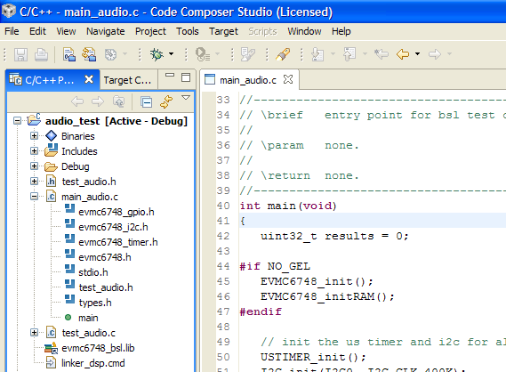
CCSv5 (Eclipse) Benefits
Eclipse Open Source Framework
Managed make files (gMake scripting)
Industry momentum (leverage work of others)
Cross-platform support (Windows/Linux – 5.x)
Plug-ins – use available or create your own
Project Management
Version control plug-ins (e.g. ClearCase)
BIOS/CGT version PER PROJECT
Licensing (free tools, floating license)
Updates available via internet
Notes:
a quick screen shot of CCS and some of its most important features. Many customers will be familiar with make files, so the concept of a project won’t be very alien.
Identify the menu bar, horizontal and vertical toolbars and project window

Slide 7
Outline
Intro to CCSv5
Functional Overview
Perspectives
Projects
Target Configuration
Build Config & Options
Licensing/Pricing
CCSv5 – For More Info…

Slide 8

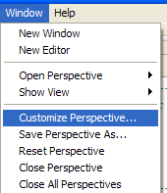
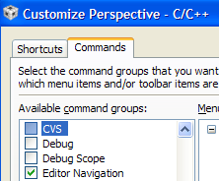
Perspectives
Perspectives – a set of windows, views and menus that correspond to a specific set of tasks
Two default perspectives are provided with CCSv5:
Debug
C/C++
Debug Views
Watch/Memory
Graphs, etc.
Code Dev’t Views
Project Contents
Editor
Users can customize perspectives and save them:
9

Slide 9
Outline
Intro to CCSv5
Functional Overview
Perspectives
Projects
Target Configuration
Build Config & Options
Licensing/Pricing
CCSv5 – For More Info…

Slide 10
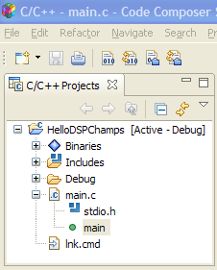
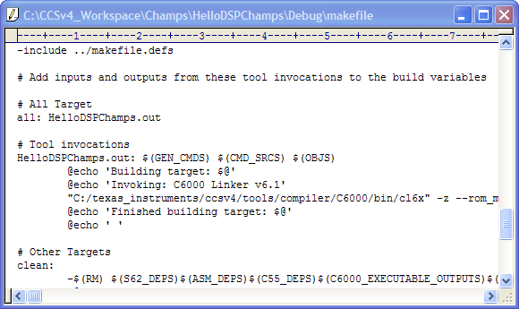
Eclipse “Projects”
CCSv5 is PROJECT-centric
Eclipse uses managed makefiles as their build scripts – as opposed to pjt files
Eclipse projects are folder based
“Adding file” copies it to folder
“Linking file” references original file
Project explorer shows folder contents
Project explorer lists functions
make file
How do we create a NEW project?

Slide 11
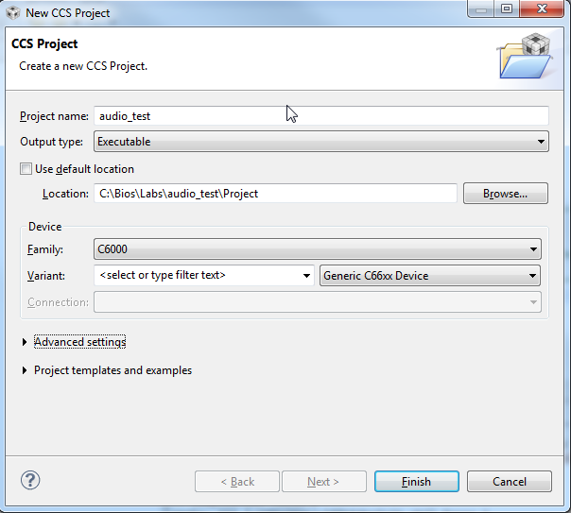
Creating a New Project (1)
File New CCS Project
(in C++ perspective)

Slide 12
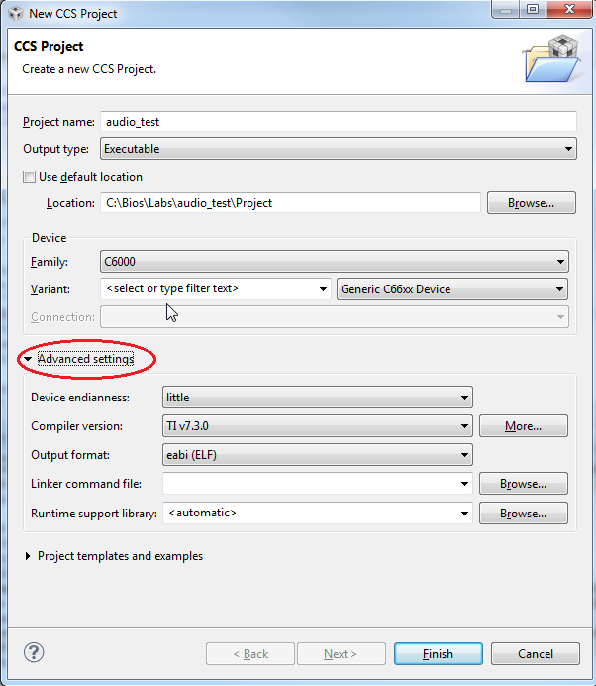
Creating a New Project (2)

Slide 13
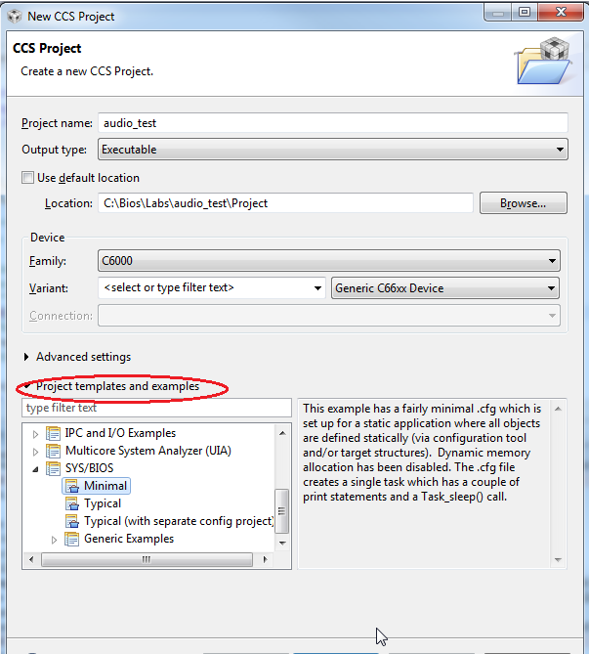
Creating a New Project (3)
Not using SYS/BIOS?
Choose “Empty Project”
Using SYS/BIOS?
Choose “Minimal” under SYS/BIOS

Slide 14

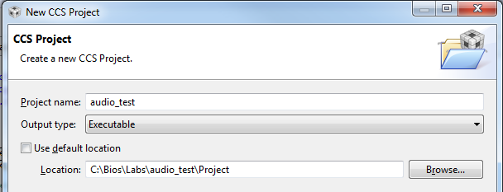
Eclipse “Workspace”
Workspace – a “container” for Eclipse metadata and the default location for all projects
Default Location: \My Documents\workspace:
Can change “default” workspace location if desired
User can also locate projects in specific folders:
14

Slide 15
Outline
Intro to CCSv5
Functional Overview
Perspectives
Projects
Target Configuration
Build Config & Options
Licensing/Pricing
CCSv5 – For More Info…
Intro to SYS/BIOS

Slide 16
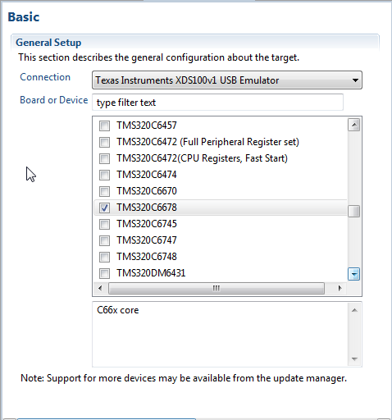
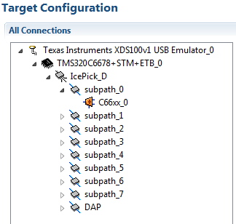
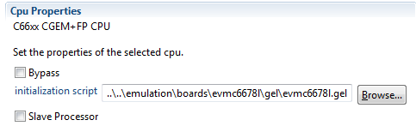
Creating a New Target Config File (.ccxml)
Target Configuration – defines your “target” – i.e. emulator/device used, GEL scripts (replaces the old CCS Setup)
Use on a per-project basis (add to project or create User Defined)
Advanced Tab
“click”
Specify GEL script here

Slide 17
Outline
Intro to CCSv5
Functional Overview
Perspectives
Projects
Target Configuration
Build Config & Options
Licensing/Pricing
CCSv5 – For More Info…

Slide 18

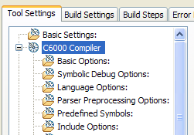
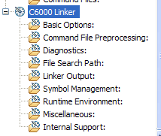
Two Default Build Configurations
Build Configuration – a set of build options for the compiler and linker (e.g. optimization levels, include DIRs, debug symbols, etc.)
CCSv5 comes std with two DEFAULT build configs: Debug & Release:
User can create their own config if desired
User can modify compiler/linker options via “Build Properties”:
Compiler
Linker
18

Slide 19
Outline
Intro to CCSv5
Functional Overview
Perspectives
Projects
Target Configuration
Build Config & Options
Licensing/Pricing
CCSv5 – For More Info…

Slide 20
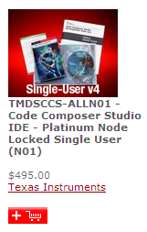
CCSv5 Licensing & Pricing
Licensing
Wide variety of options (node locked, floating, time based…)
All versions (full, DSK, free tools) use same image
Updates readily available via the internet
Pricing
Reasonable pricing – includes FREE options noted below
Item | Description | Price
Platinum Eval Tools | Full tools with 30 day limit (all EMU) | FREE
Platinum Bundle | EVM, sim, XDS100 use | FREE ☺
Platinum Node Locked | Full tools tied to a machine | $495 (1)
Platinum Floating | Full tools shared across machines | $795 (1)
Microcontroller Core | MSP/C2000 code size limited | FREE
Microcontroller Node Locked | MSP/C2000 | $445
☺ - recommended option: purchase Dev Kit, use XDS100v1-2, & Free CCSv5

Slide 21
Outline
Intro to CCSv5
Functional Overview
Perspectives
Projects
Target Configuration
Build Config & Options
Licensing/Pricing
CCSv5– For More Info…

Slide 22
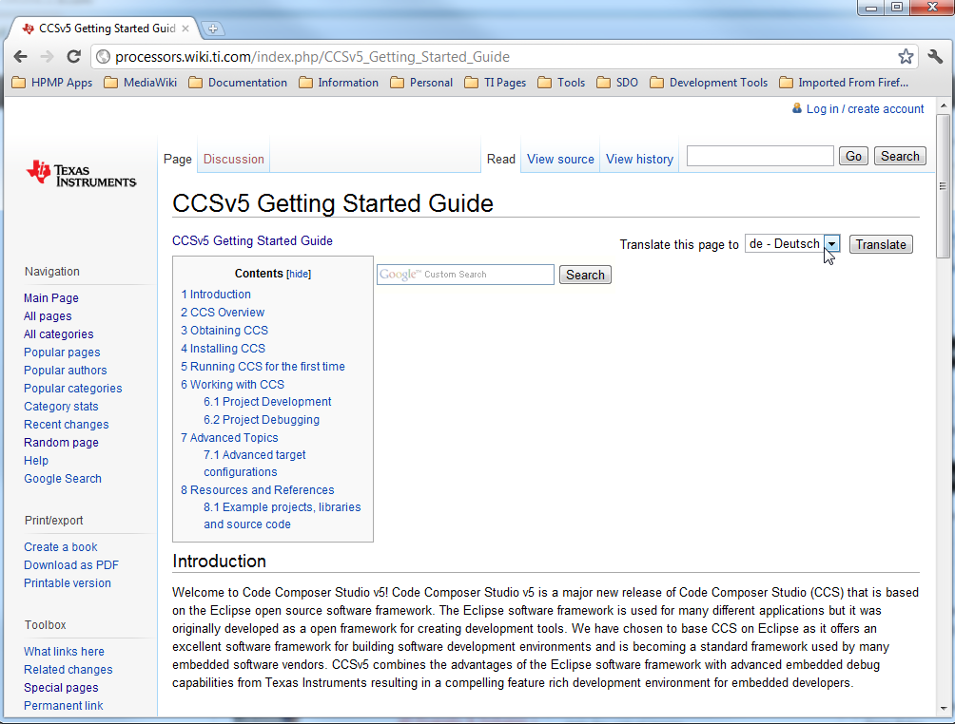
CCSv5 – For More Info…
Links for:
Downloading CCSv5
Installation Help
Licensing
Tutorials
BIOS Projects
Etc.
22

Slide 23
Questions?

